Slide 1
Microbiome Analysis
Parts 1-4
FAIR 2025
Yasmin Hilliam, PhD & Rebecca Valls, PhD

Slide 2
Microbiome Analysis
Part 1
Part 2
Part 3
Part 4
Experimental Design
DADA2
QC filtering, trimming, and merging
Building ASV counts table and preparing metadata
Phyloseq
Alpha diversity, beta diversity, relative abundance
Statistics on Microbiome Data
Data formatting and common statistical analyses

Slide 3
Microbiome Analysis
Part 1
Part 2
Part 3
Part 4
Experimental Design
DADA2
QC filtering, trimming, and merging
Building ASV counts table and preparing metadata
Phyloseq
Alpha diversity, beta diversity, relative abundance
Statistics on Microbiome Data
Data formatting and common statistical analyses
Have a broad understanding of microbiome experimental design.

Slide 4
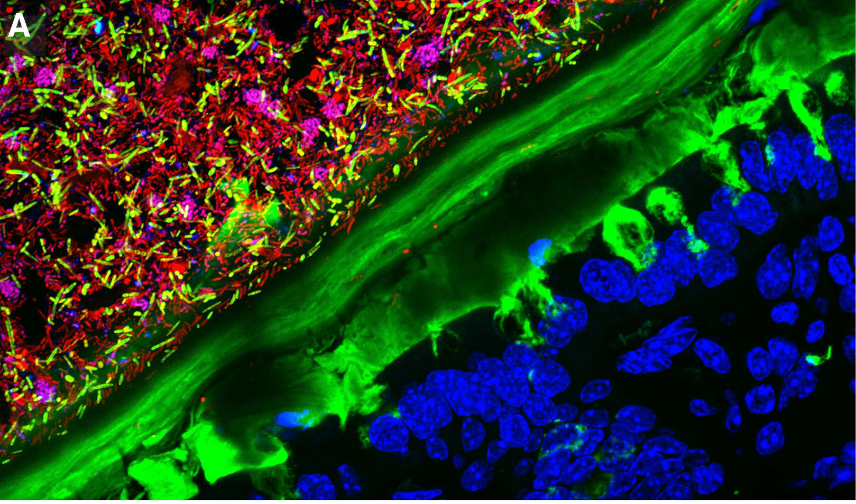
The Microbiome
Tropini et al., 2017
Notes:
The microbiome refers to the collection of genomes from microorganisms, including bacteria, viruses, fungi, and other microbes, that inhabit a particular environment, such as the human gut, soil, or water.
In this presentation, we will explore the key aspects of designing microbiome experiments, including the types of questions researchers ask, the available data types, experimental design considerations, important controls, and tools for analyzing microbiome data.
https://www.cell.com/cell-host-microbe/fulltext/S1931-3128(17)30120-8

Slide 5
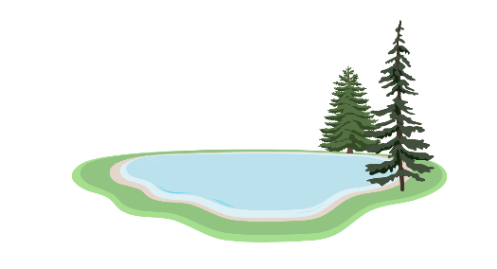
Common Research Questions
What is the composition of the microbiome in a particular environment or host?
How does the microbiome change in response to factors like fertilizers, increasing CO² levels, diet, disease, or medication? Over time?
What functions do specific microorganisms or microbial communities perform within their ecosystems?

Slide 6
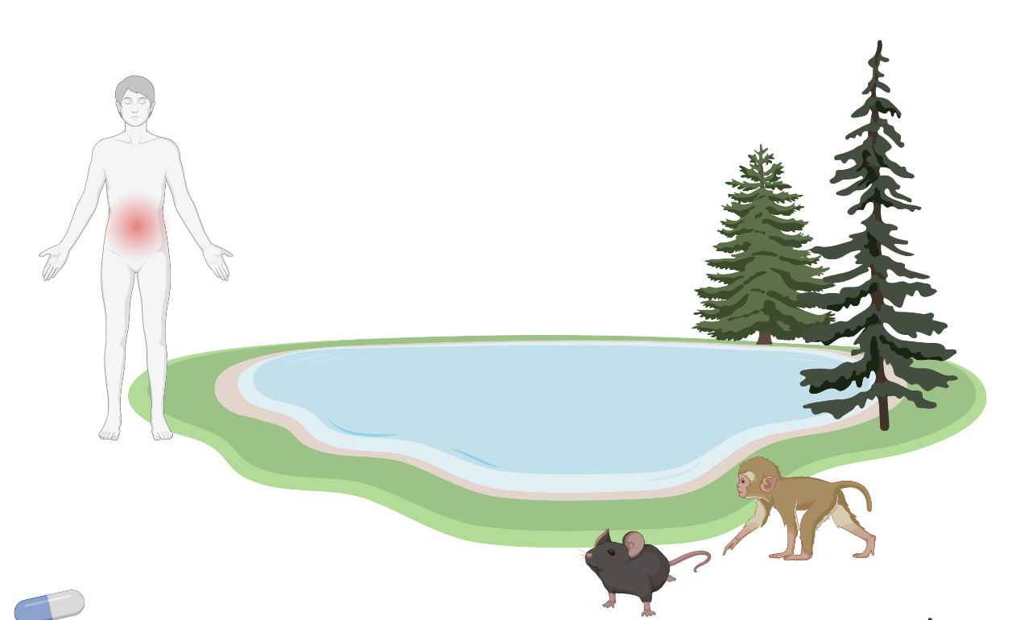
Common Research Questions
What is the composition of the microbiome in a particular environment or host?
How does the microbiome change in response to factors like fertilizers, increasing CO² levels, diet, disease, or medication? Over time?
What functions do specific microorganisms or microbial communities perform within their ecosystems?

Slide 7
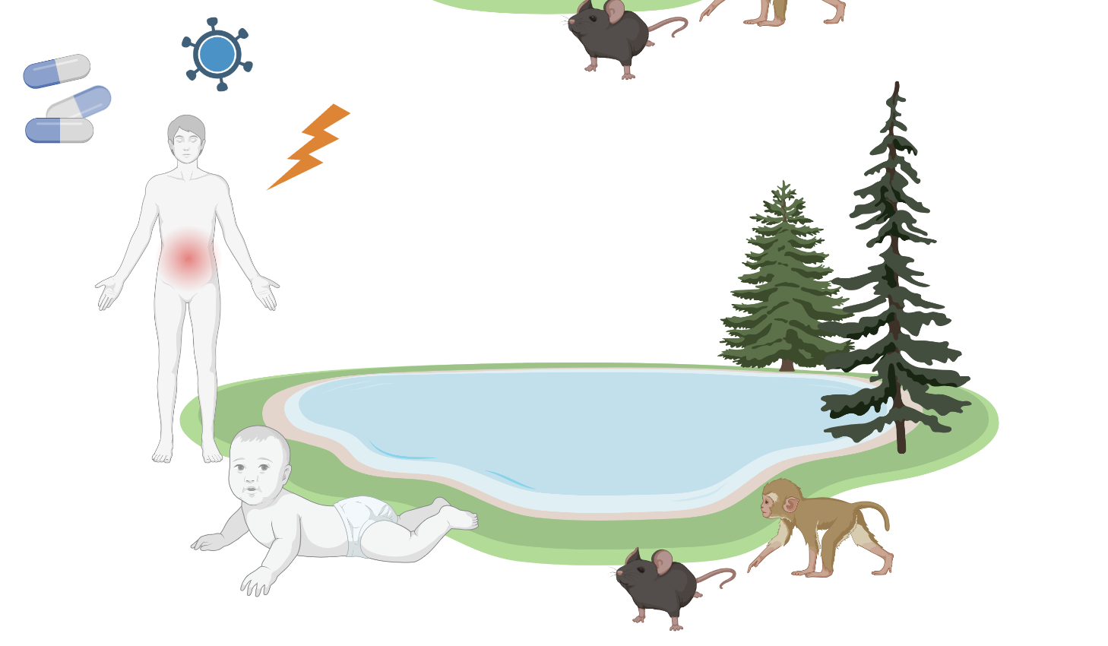
Common Research Questions
What is the composition of the microbiome in a particular environment or host?
How does the microbiome change in response to factors like fertilizers, increasing CO² levels, diet, disease, or medication? Over time?
What functions do specific microorganisms or microbial communities perform within their ecosystems?

Slide 8
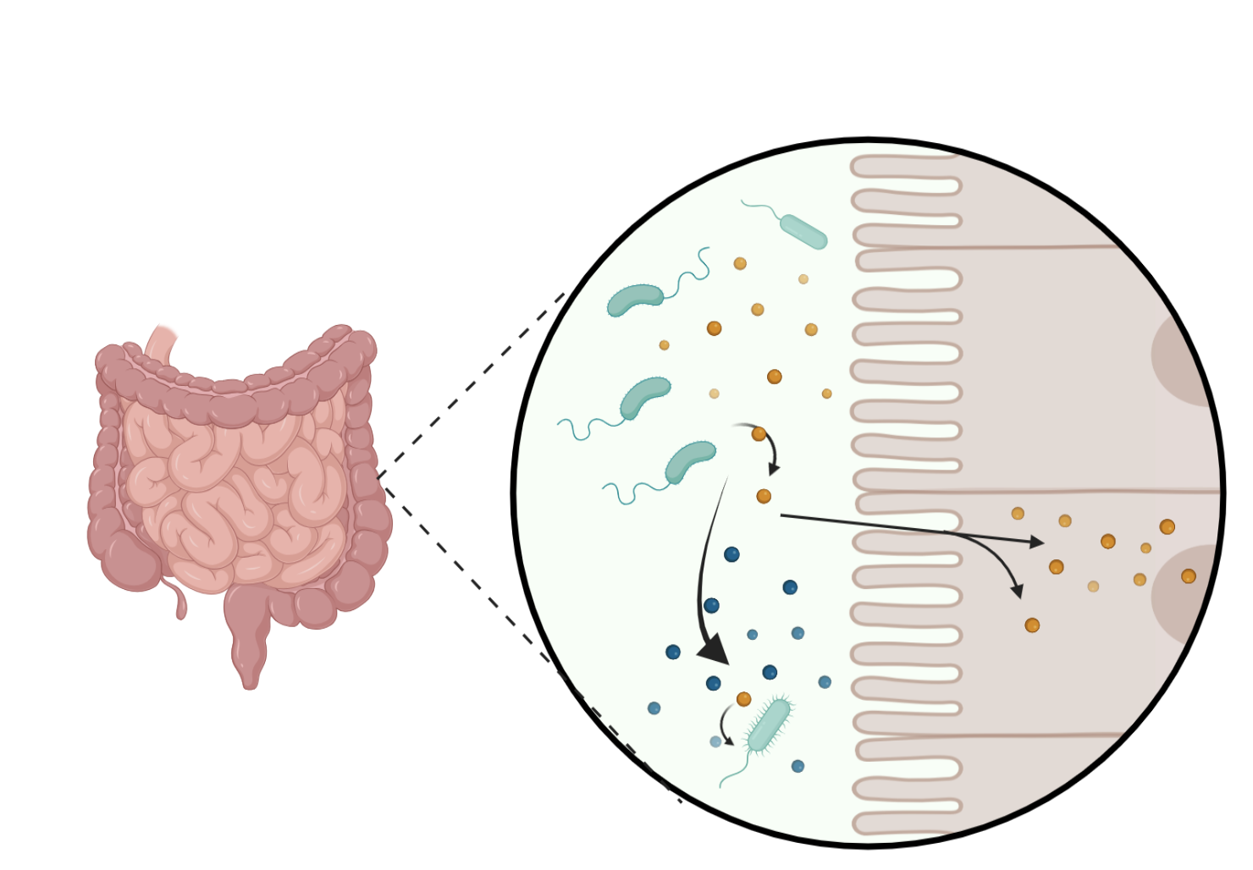
Common Research Questions
What is the composition of the microbiome in a particular environment or host?
How does the microbiome change in response to factors like fertilizers, increasing CO² levels, diet, disease, or medication? Over time?
What functions do specific microorganisms or microbial communities perform within their ecosystems?

Slide 9
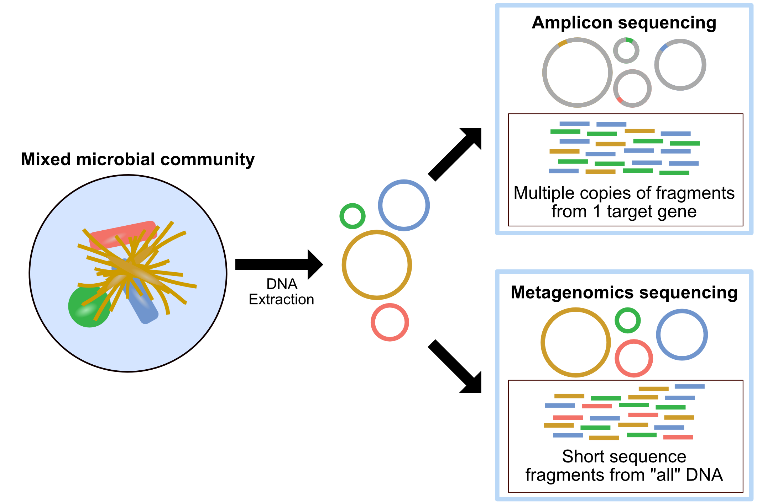
Types of Data in Microbiome Research
Happy Belly Bioinformatics
Notes:
16S rRNA gene sequencing: Provides information on microbial community composition and diversity.
Metagenomic sequencing: Captures the genetic material of all microorganisms present, allowing for functional analysis.
Metatranscriptomic and metaproteomic data: Reveal gene expression and protein profiles, respectively.
Host response: transcriptomic (qPCR, RNAseq) and proteomics (ELISAs and Luminex)

Slide 10
Types of Data in Microbiome Research
Happy Belly Bioinformatics
Notes:
16S rRNA gene sequencing: Provides information on microbial community composition and diversity.
Metagenomic sequencing: Captures the genetic material of all microorganisms present, allowing for functional analysis.
Metatranscriptomic and metaproteomic data: Reveal gene expression and protein profiles, respectively.
Host response: transcriptomic (qPCR, RNAseq) and proteomics (ELISAs and Luminex)

Slide 11
Types of Data in Microbiome Research
ASVs
(amplicon sequence variants)
Happy Belly Bioinformatics
Notes:
16S rRNA gene sequencing: Provides information on microbial community composition and diversity.
Metagenomic sequencing: Captures the genetic material of all microorganisms present, allowing for functional analysis.
Metatranscriptomic and metaproteomic data: Reveal gene expression and protein profiles, respectively.
Host response: transcriptomic (qPCR, RNAseq) and proteomics (ELISAs and Luminex)

Slide 12
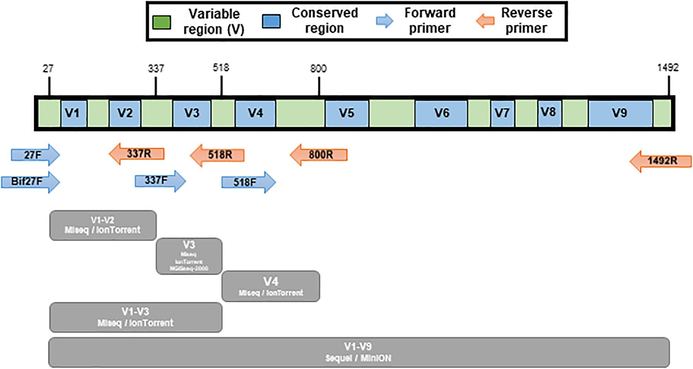
Illustration of variable regions within the 16S rRNA gene
Park et al., 2021

Slide 13
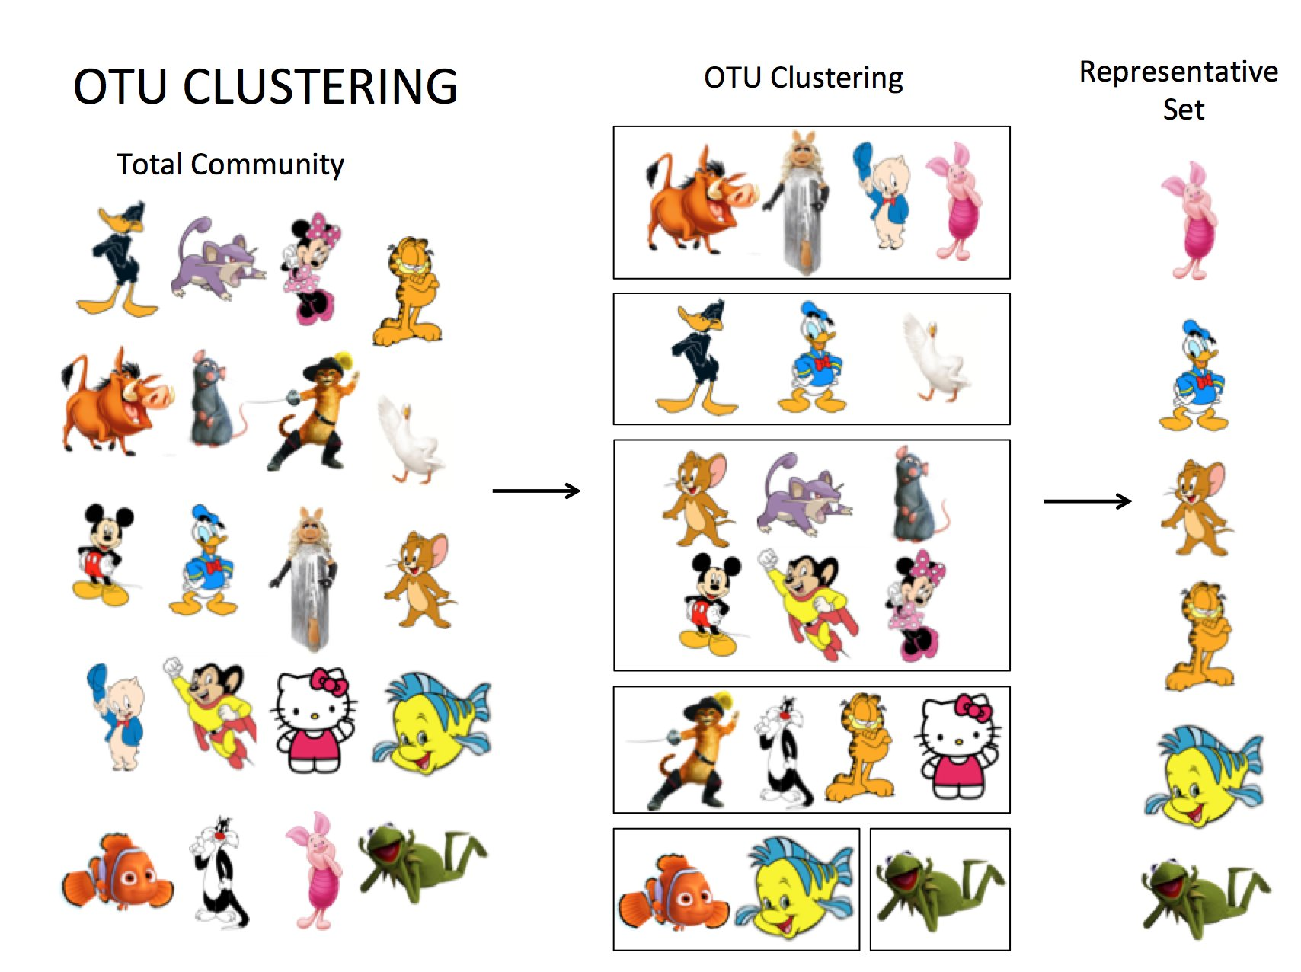
OTUs vs ASVs
Clusters sequences together
based on similarity threshold of 97%
Notes:
https://twitter.com/kmyoshimura/status/1082489532052844544
Assistant Professor of Biology @JMU
. I study marine and aquatic microbial ecology and ecophysiology. All opinions my own.

Slide 14
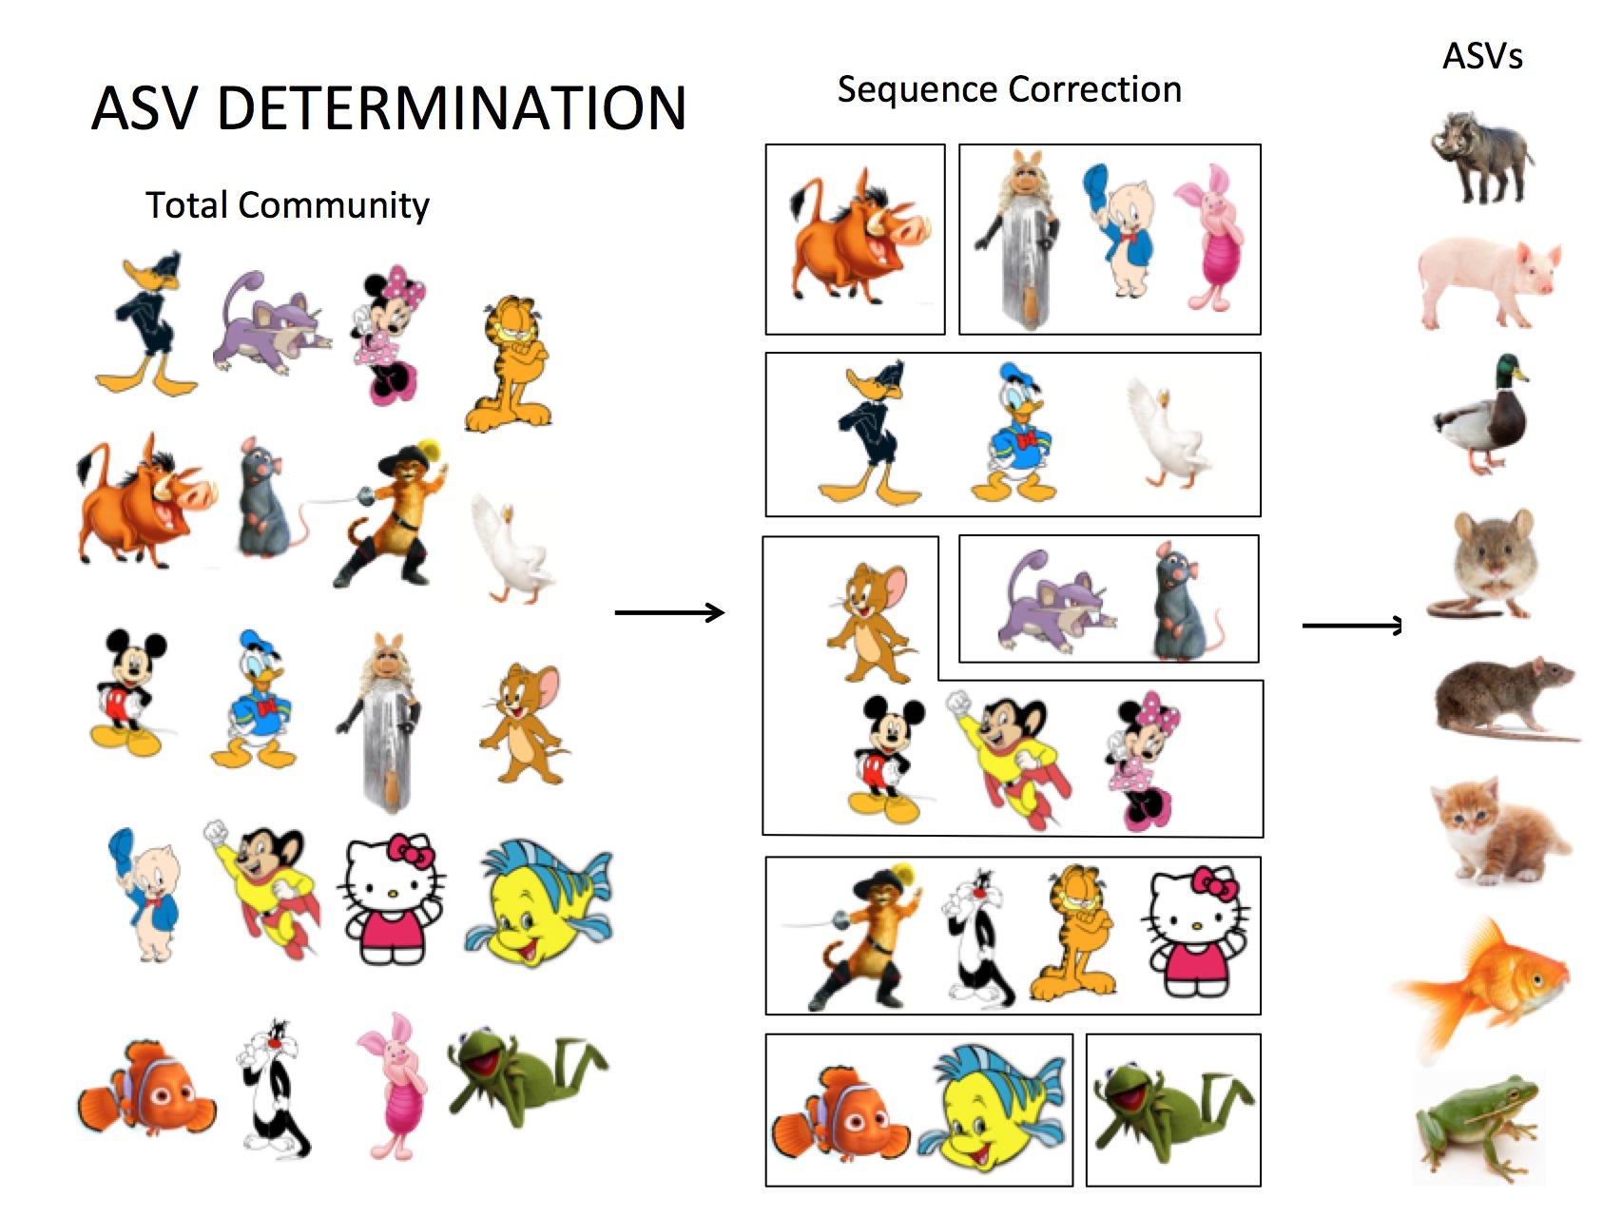
ASVs vs OTUs
Clusters sequences together
based on similarity threshold of 97%
Identifies single, exact sequences
Kristin Yoshimura Twitter
Notes:
https://twitter.com/kmyoshimura/status/1082489532052844544
Assistant Professor of Biology @JMU
. I study marine and aquatic microbial ecology and ecophysiology. All opinions my own.

Slide 15
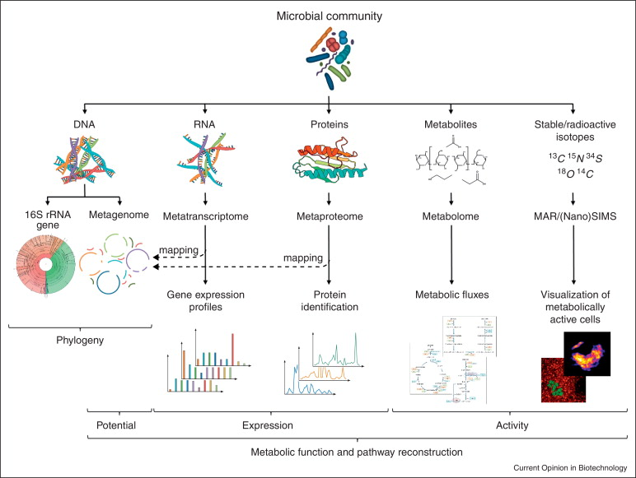
Types of Data in Microbiome Research
Vanwonterghem et al., 2014
Notes:
Add ASV vs OTU16S rRNA gene sequencing: Provides information on microbial community composition and diversity.
Metagenomic sequencing: Captures the genetic material of all microorganisms present, allowing for functional analysis.
Metatranscriptomic and metaproteomic data: Reveal gene expression and protein profiles, respectively.
Host response: transcriptomic (qPCR, RNAseq) and proteomics (ELISAs and Luminex)
https://www.sciencedirect.com/science/article/pii/S0958166913007040?via%3Dihub

Slide 16
Designing Robust Microbiome Experiments
Define research objectives and questions clearly.
Select appropriate sampling strategies: cross-sectional, longitudinal, or case-control.
Consider sample size calculations and statistical power to ensure adequate data resolution.
Randomization and blinding: Minimize bias and confounding factors.
Standardize protocols for sample collection, storage, DNA extraction, and controls.
Goodrich et al., 2014
Notes:
Sending all samples together in one batch, one making sure to account for sequencing batch in your analysis (make sure they don’t cluster)
https://www.sciencedirect.com/science/article/pii/S0092867414008642?via%3Dihub
Is this an observational study vs a study trying to determine cause?
Are you interested in single or multiple time points? Cross sectional sampling are collected from individuals at a single time point. Longitudinal sampling involved repeated sampling of the same individual over a period of time. Case control sampling aims to compare individuals with a specific condition or disease to inviduals without the condition or disease.
Run a power analysis on pilot or previously published data to determine how many samples you need.
If collecting human samples, have the parties collecting the samples randomize them before handing them over to the researchers. Confirm that the samples are homogenous in their comprehensive metadata to be avoid confounding factors (ie all of your control group came from one hospital and your treatment goup came from another hospital - you can’t account for the hospital being a confounding factor).
Collection, storage, DNA extraction protocol can all affect microbiome samples so making sure that all of the samples in an experiment are being treated the same prior to starting the experiment. Also, include necessary microbiome controls. While studies have shown that storing stool samples in a -80’C vs 20 did not have significant affects on the sample’s microbial diversity, the number of freeze thaw cycles does affect the composition of the community

Slide 17
Important Controls in Microbiome Experiments
Negative Controls:
Collection and Extraction negative controls: These are samples that go through the same sample collection and DNA extraction process as the study samples but do not contain any biological material. They help identify potential contamination during the sample collection, DNA extraction, and library prep process.
Positive Controls:
Mock communities: These are artificially created microbial communities with known compositions. They serve as positive controls to assess the accuracy and reliability of sequencing, bioinformatics pipelines, and taxonomic assignment methods. Mock communities can help determine sequencing errors, bias, and the detection limit of the experimental workflow.
Spiked in microbe: In these experiments, a known microbial species or DNA is deliberately added to a sample to assess the ability of the experimental protocol to detect and quantify the added microbe. This microbe can also be normalized against to obtain absolute counts.
Experimental Controls:
Replicate Samples: Including replicate samples from the same individuals or biological samples helps assess the variability and reproducibility of the microbiome data.
Intervention Controls: In intervention studies, including control groups that do not receive the intervention or receive a placebo helps differentiate the effects of the intervention from background variation.
Notes:
Intervention should also add baseline controls.
Repeated collections over time.

Slide 18
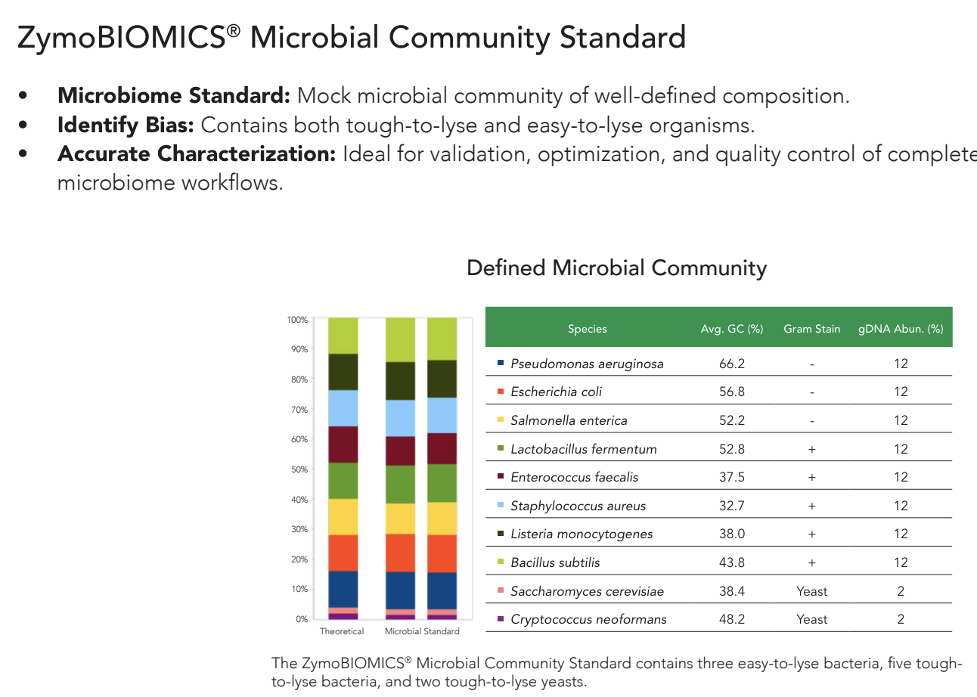
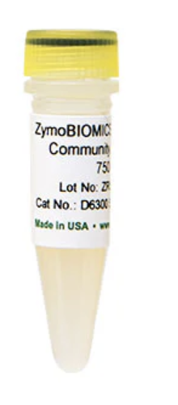

Slide 19
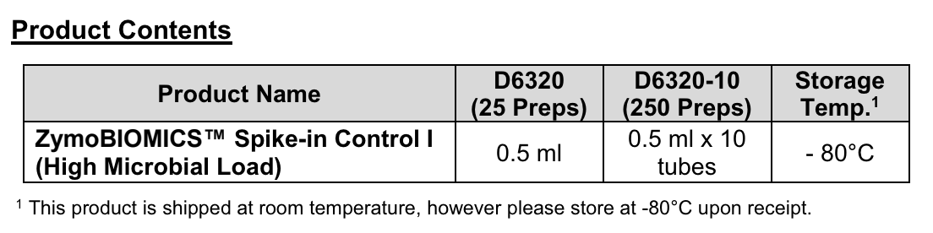
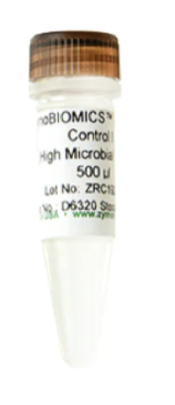
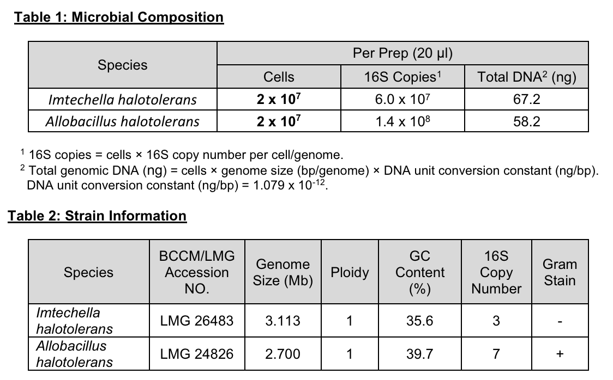
Spike-in Control

Slide 20
Tools for Microbiome Data Analysis
Sequence Processing:
CUTADAPT: A bioinformatic tool written in Python used for the removal of adapter and primer sequences
DADA2: A popular tool for denoising, error correction, and inference of amplicon sequence variants (ASVs) from raw sequencing data.
QIIME 2: A comprehensive microbiome analysis platform that provides various preprocessing methods, including quality filtering, demultiplexing, and primer trimming.
USEARCH-UNOISE3: A tool that employs a unique error model to denoise and identify ASVs from high-throughput sequencing data. It can be an alternative to DADA2 and is known for its ability to handle low-quality reads and amplicons with high error rates.
Microbiome Visualization:
R packages: Phyloseq, MicrobiomeR, ggplot2, and ComplexHeatmap are commonly used R packages for visualizing microbiome data, generating heatmaps, bar plots, and ordination plots.
Qiime 2: The QIIME 2 platform provides multiple visualization tools, including Emperor for visualizing principal coordinate analysis (PCoA) results and taxa summaries.
Statistics and Analysis:
R packages: DESeq2, edgeR, vegan, limma, ALDEx2, metagenomeSeq are popular R packages for differential abundance analysis, community diversity analysis, and differential expression analysis.
QIIME 2: The QIIME 2 platform includes a range of statistical methods and workflows for alpha and beta diversity analysis, differential abundance testing, and other statistical analyses.
LEfSe: A tool specifically designed for identifying differentially abundant microbial features across multiple groups or conditions.

Slide 21
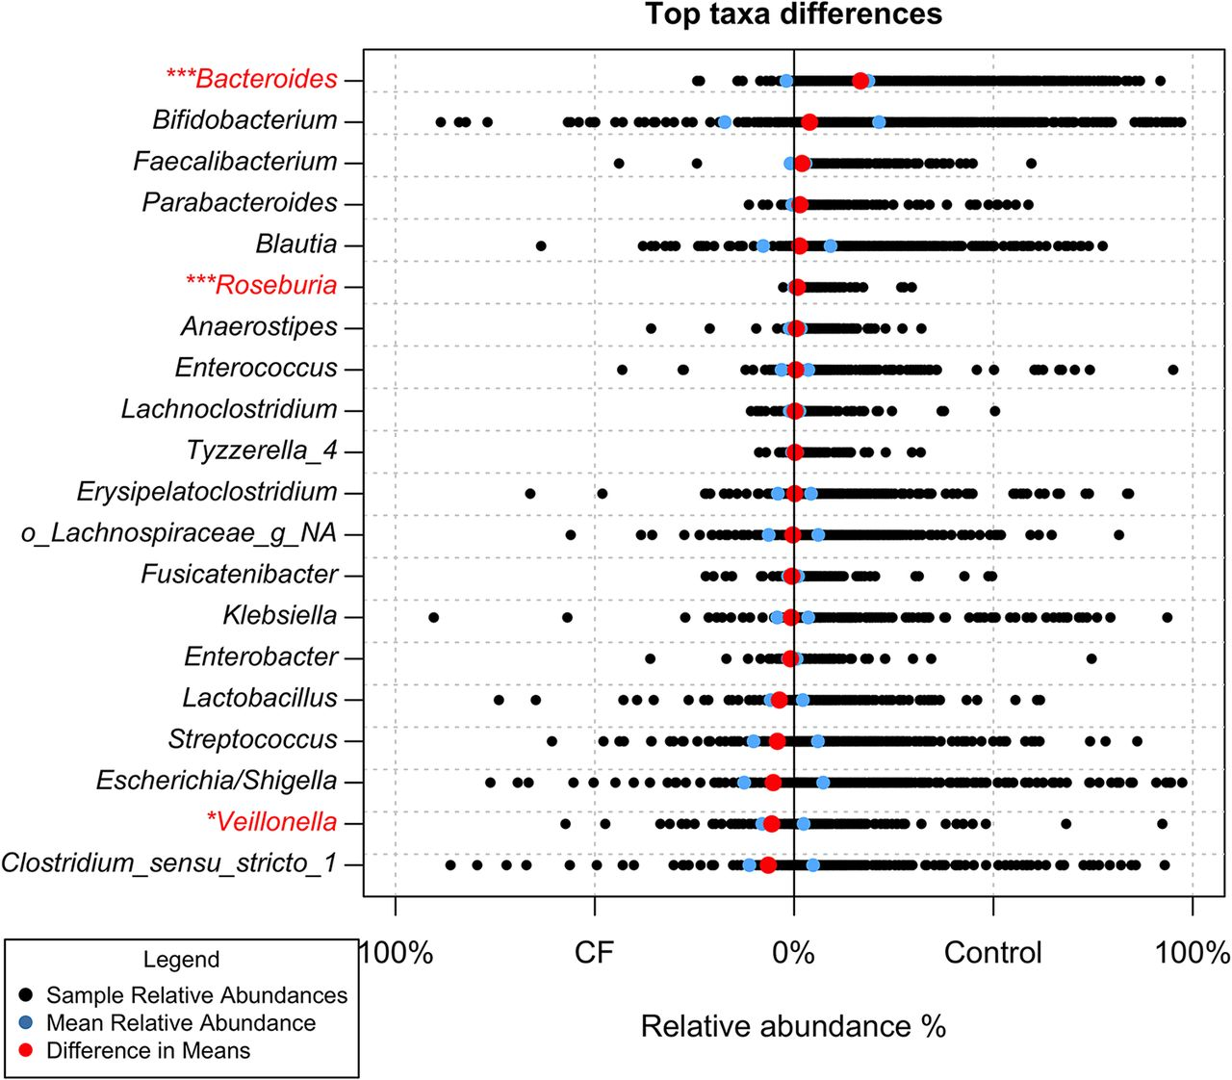
Relative abundances of Bacteroides in the gut of children with and without CF
Antosca 2019
Notes:
The same trend exists in our local cohort of children with CF. this work was done by a previous graduate student from the O’Toole lab. When comparing the gut microbiota across the first year of life between CF and nonCF infants, she found that….

Slide 22
Bacteroides is less abundant in CF cohorts
Antosca 2019
Notes:
Bacteroides was significantly less abundant in the CF cohort, evident by the red dot to the right.

Slide 23
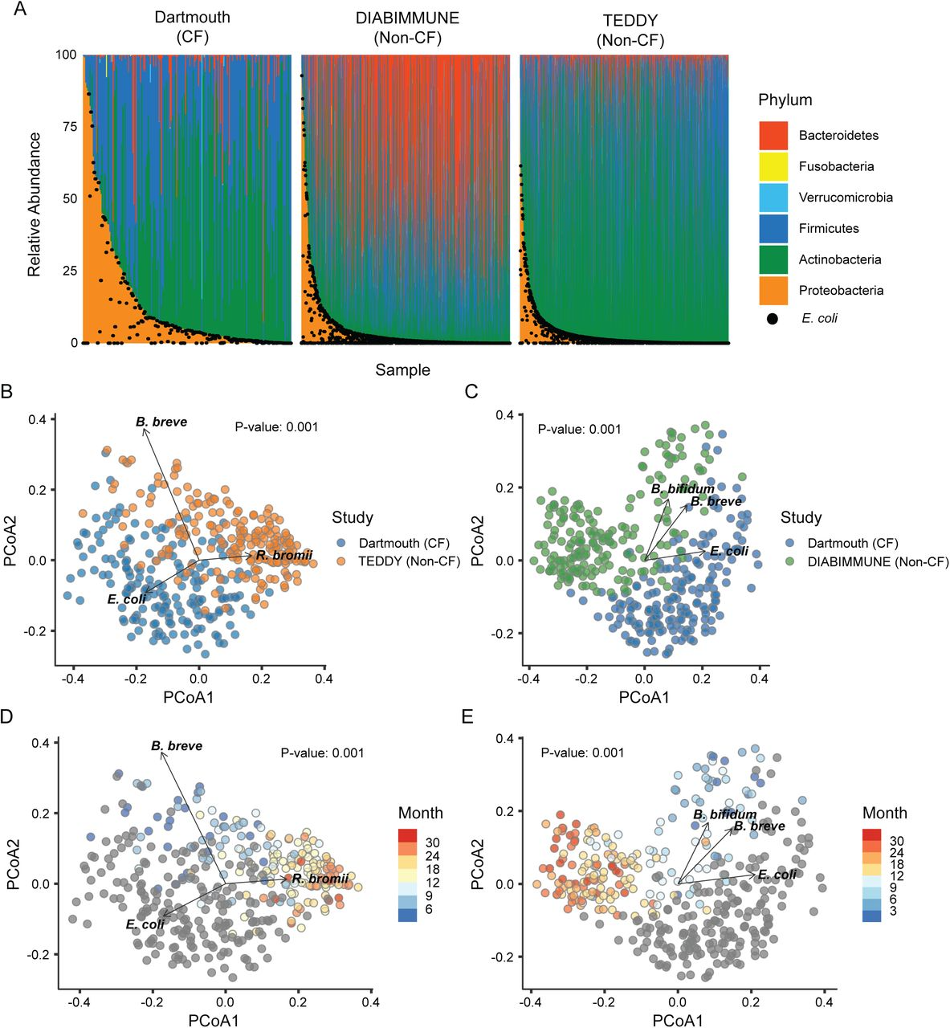
Bacteroides is less abundant in CF cohorts
Sample
Adapted from P. Salerno,…R. Valls et al., bioRxiv
2023.05.02.539134
Notes:
In order to better understand the differences in intestinal microbiota, our collaborators performed metagenomic shotgun sequencing on fecal samples from a prospective cohort of 40 infants with CF and compared those samples taxonomy to that of published nonCF datasets from the DIABIMMUNE and TEDDY studies.
These plots depict relative abundance of phyla in the stool of children from three separate cohorts. Each phylum is represented by a different color.
As seen in previous 16s datasets, the phylum Bacteroidetes (depicted by the dark orange) is notably less abundance in the CF cohort.
emphasize the decreased red orange/rusty red
say that we submitted the samples and that got help analyzing with ross lab
Show Kathy’s paper, then introduce this one, mention Luke Hoffman showed a similar thing

Slide 24


The role of Bacteroides in the murine gut-lung axis
Kaitlyn Barrack
Sarvesh Surve
Created on Biorender

Slide 25
The role of Bacteroides in the murine gut-lung axis
Kaitlyn Barrack
Sarvesh Surve
16s Sequencing: V3/V4 regions of the 16s gene, sequenced on a V3 MiSeq 622cyc flowcelll to generate 2x301bp PE reads
Created on Biorender

Slide 26
Intestinal supplementation of Bacteroides prevents increase in proinflammatory cytokine levels
Treatment *
Sex **
Cage **
Treatment *
Sex ns
Cage ns

Slide 27
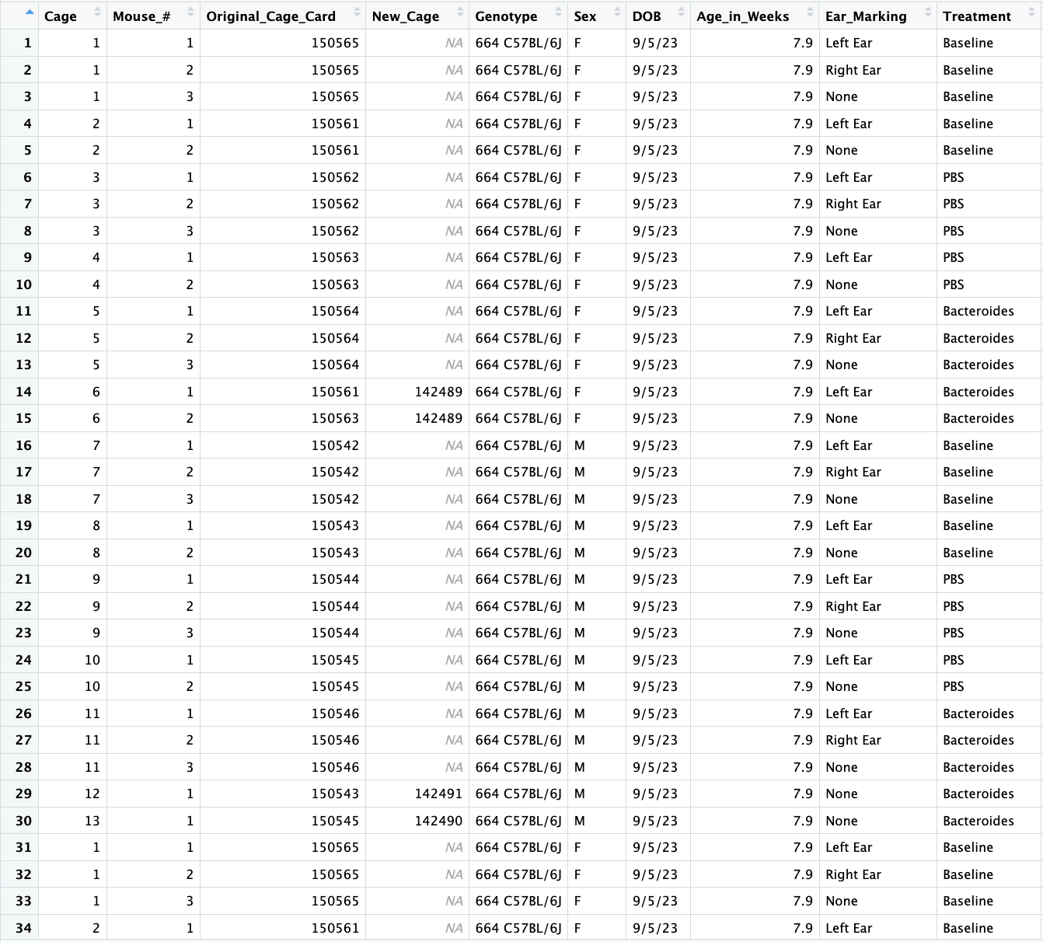
Sample metadata

Slide 28
Microbiome Analysis
Part 1
Part 2
Part 3
Part 4
Experimental Design
DADA2*
QC filtering, trimming, and merging
Building ASV counts table and preparing metadata
Phyloseq
Alpha diversity, beta diversity, relative abundance
ML on Microbiome Data
Data formatting and random forest models
Have a broad understanding of microbiome experimental design.
Start with fastq files and end with an ASVcounts table.
Notes:
We are first going to run this with a subset of samples, and then cooking show style, I have the complete files ready for you.

Slide 29
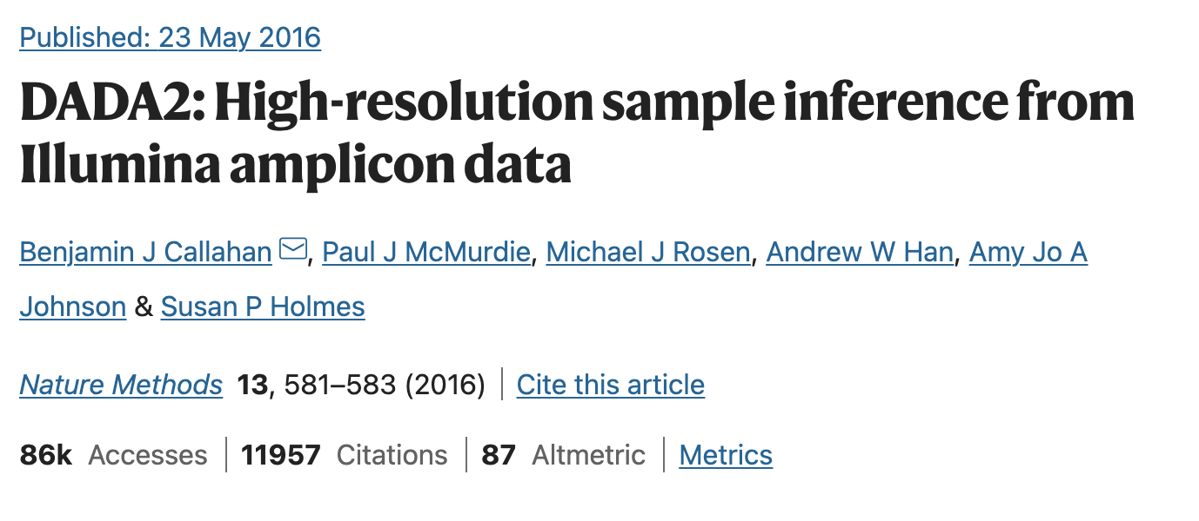
Workflow:
Organize your directory
Check quality
Learn the error rates
Sample Inference
Merge paired-reads
Remove chimeras
Assign taxonomy
Generate final tables
Notes:
If you received reads that did not have adapters and primers removed, then there are tools like cutadapt, that remove them.

Slide 30
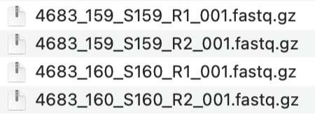
Project
Name
Sequencing
Identifier
Workflow:
Organize your directory
Check quality, filter and trim
Learn the error rates
Sample Inference
Merge paired-reads
Remove chimeras
Assign taxonomy
Generate final tables
Sample
Identifier
R1 for Forward
R2 for Reverse

Slide 31
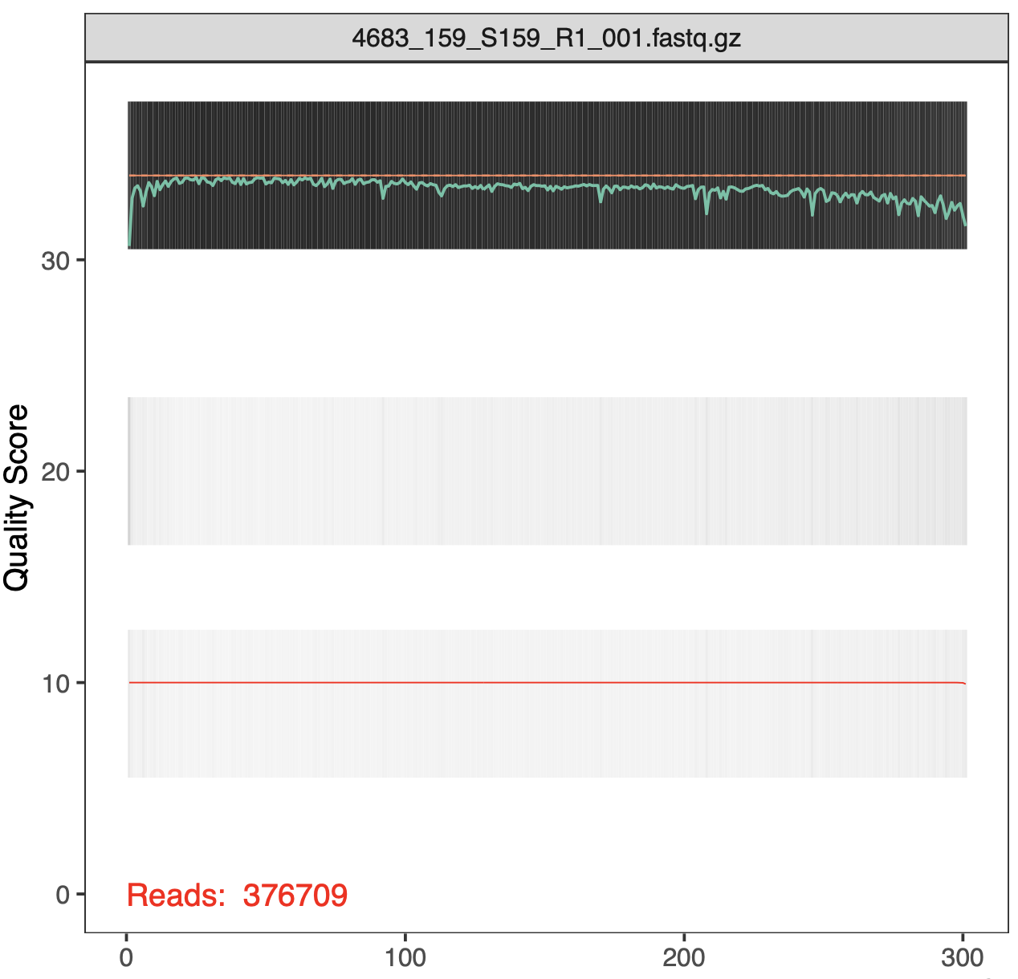
Workflow:
Organize your directory
Check quality, filter and trim
Learn the error rates
Sample Inference
Merge paired-reads
Remove chimeras
Assign taxonomy
Generate final tables
Notes:
In gray-scale is a heat map of the frequency of each quality score at each base position. The mean quality score at each position is shown by the green line, and the quartiles of the quality score distribution by the orange lines. The red line shows the scaled proportion of reads that extend to at least that position (this is more useful for other sequencing technologies, as Illumina reads are typically all the same length, hence the flat red line).
The reverse reads are of significantly worse quality, especially at the end, which is common in Illumina sequencing. This isn’t too worrisome, as DADA2 incorporates quality information into its error model which makes the algorithm robust to lower quality sequence, but trimming as the average qualities crash will improve the algorithm’s sensitivity to rare sequence variants. Based on these profiles, we will truncate the reverse reads at position 160 where the quality distribution crashes.

Slide 32
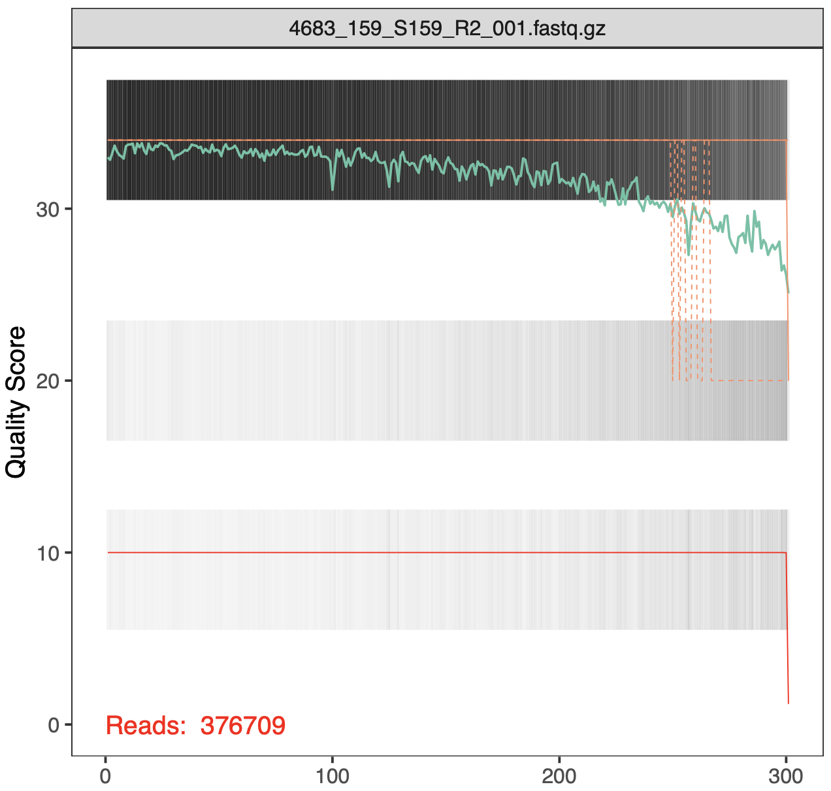
Workflow:
Organize your directory
Check quality, filter and trim
Learn the error rates
Sample Inference
Merge paired-reads
Remove chimeras
Assign taxonomy
Generate final tables
Notes:
In gray-scale is a heat map of the frequency of each quality score at each base position. The mean quality score at each position is shown by the green line, and the quartiles of the quality score distribution by the orange lines. The red line shows the scaled proportion of reads that extend to at least that position (this is more useful for other sequencing technologies, as Illumina reads are typically all the same length, hence the flat red line).
The reverse reads are of significantly worse quality, especially at the end, which is common in Illumina sequencing. This isn’t too worrisome, as DADA2 incorporates quality information into its error model which makes the algorithm robust to lower quality sequence, but trimming as the average qualities crash will improve the algorithm’s sensitivity to rare sequence variants. Based on these profiles, we will truncate the reverse reads at position 160 where the quality distribution crashes.

Slide 33
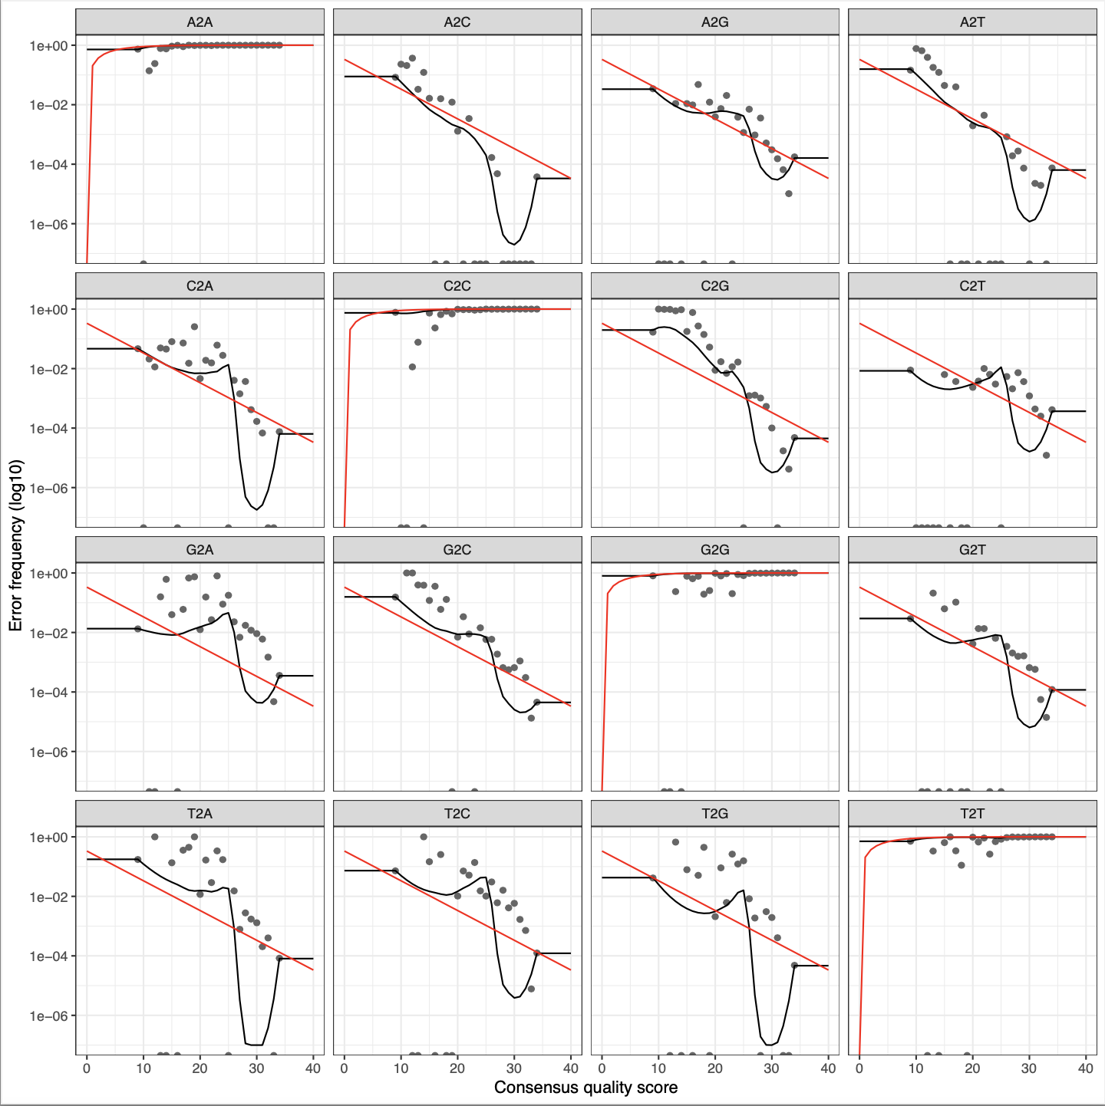
Workflow:
Organize your directory
Check quality, filter and trim
Learn the error rates
Sample Inference
Merge paired-reads
Remove chimeras
Assign taxonomy
Generate final tables
Notes:
Understanding the Plot:
Gray Dots: Each gray dot represents the observed error rate for a particular type of nucleotide substitution (e.g., A to G, C to T) at a given quality score.
Red Line: The red line represents the fitted error model, which is the predicted error rate for each nucleotide substitution at each quality score.
Systematic Bias:
If the gray dots consistently fall above or below the red line, it suggests that the error model is systematically underestimating or overestimating the true error rates for certain substitutions or quality scores.
Model Fit Quality:
Misalignment indicates that the error model does not fit the observed error rates well. This could be due to various reasons such as insufficient data for certain substitutions or poor initial parameter estimates.

Slide 34

Workflow:
Organize your directory
Check quality, filter and trim
Learn the error rates
Sample Inference
Merge paired-reads
Remove chimeras
Assign taxonomy
Generate final tables
Notes:
We are now ready to apply the core sample inference algorithm to the filtered and trimmed sequence data.

Slide 35
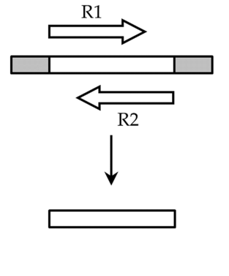
Workflow:
Organize your directory
Check quality, filter and trim
Learn the error rates
Sample Inference
Merge paired-reads
Remove chimeras
Assign taxonomy
Generate final tables

Slide 36
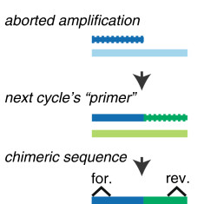
Workflow:
Organize your directory
Check quality, filter and trim
Learn the error rates
Sample Inference
Merge paired-reads
Remove chimeras
Assign taxonomy
Generate final tables

Slide 37
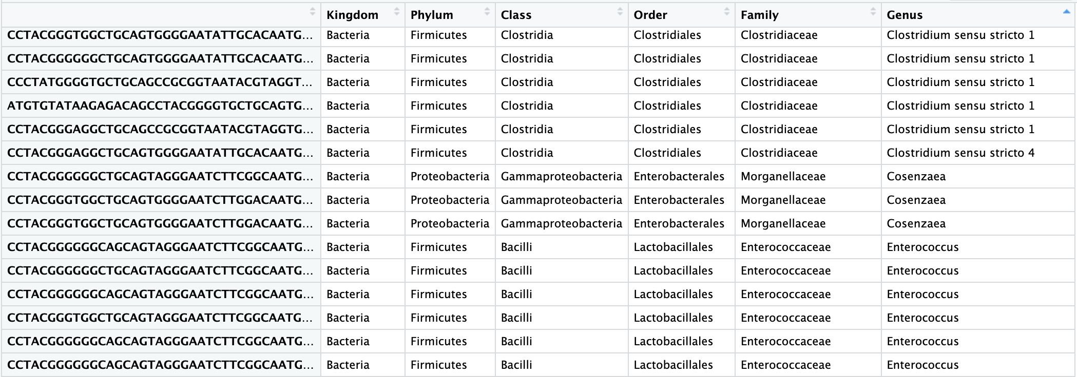
Workflow:
Organize your directory
Check quality, filter and trim
Learn the error rates
Sample Inference
Merge paired-reads
Remove chimeras
Assign taxonomy
Generate final tables

Slide 38
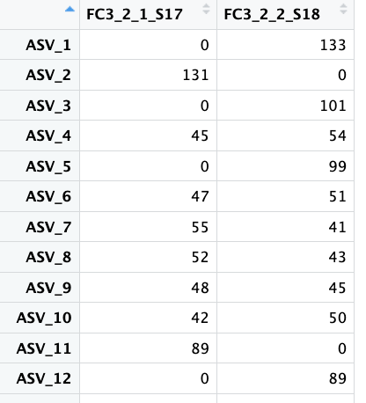
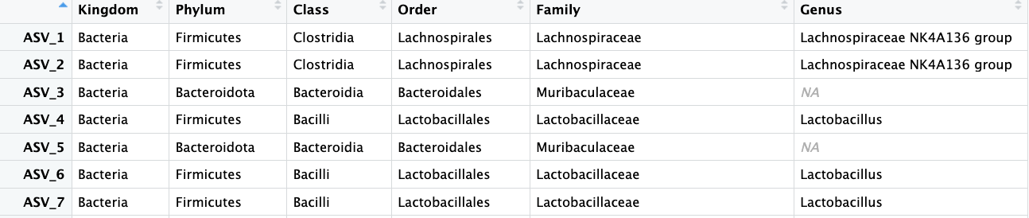
ASV Count Table
Workflow:
Organize your directory
Check quality, filter and trim
Learn the error rates
Sample Inference
Merge paired-reads
Remove chimeras
Assign taxonomy
Generate final tables
ASV Taxa Table

Slide 39
Microbiome Analysis
Part 1
Part 2
Part 3
Part 4
Experimental Design
DADA2
QC filtering, trimming, and merging
Building ASV counts table and preparing metadata
Phyloseq
Alpha diversity, beta diversity, relative abundance
Statistics on Microbiome Data
Data formatting and common statistical analyses
Have a broad understanding of microbiome experimental design.
Start with fastq files and end with a ASVcounts table.
Build a phyloseq object and make some figures using ggplot2 syntax.
Notes:
Add slides on alpha diversity and beta diversity

Slide 40
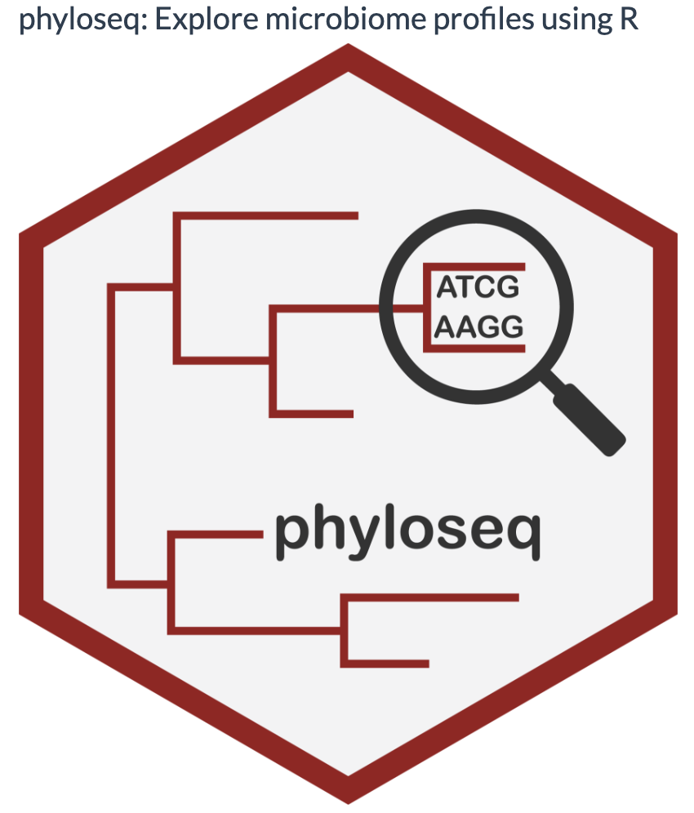
Building a phyloseq object
Notes:
The phyloseq package is a tool to import, store, analyze, and graphically display complex phylogenetic sequencing data that has already been clustered into Operational Taxonomic Units (OTUs), especially when there is associated sample data, phylogenetic tree, and/or taxonomic assignment of the OTUs.

Slide 41
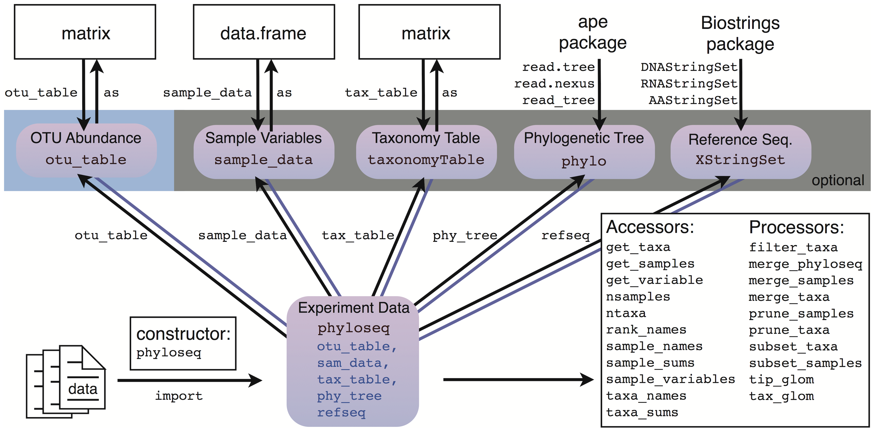
Building a phyloseq object
Notes:
The phyloseq package is a tool to import, store, analyze, and graphically display complex phylogenetic sequencing data that has already been clustered into Operational Taxonomic Units (OTUs), especially when there is associated sample data, phylogenetic tree, and/or taxonomic assignment of the OTUs.

Slide 42
Building a phyloseq object
Notes:
The phyloseq package is a tool to import, store, analyze, and graphically display complex phylogenetic sequencing data that has already been clustered into Operational Taxonomic Units (OTUs), especially when there is associated sample data, phylogenetic tree, and/or taxonomic assignment of the OTUs.

Slide 43
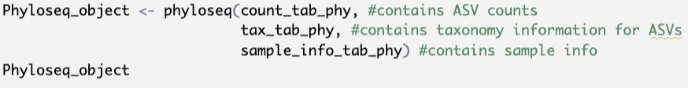
Building a phyloseq object

Slide 44
Building a phyloseq object
Now we can plot:
Alpha Diversity
Beta Diversity
Relative Abundance

Slide 45
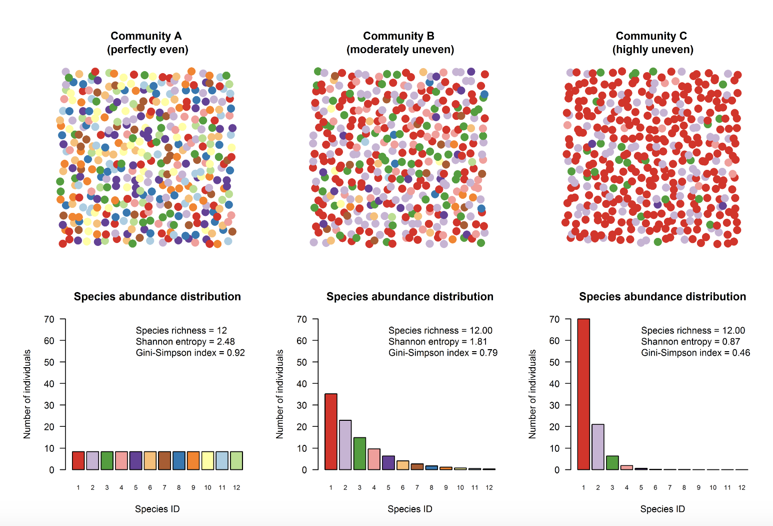
Alpha diversity is a metric used to asses the diversity within microbial communities
David Zeleny
Notes:
It takes into account the number of different species present in a community (richness) as well as their relative abundances (evenness). The metric is based on information theory, and it calculates the amount of information contained in the species abundance distribution of a community. The higher the Shannon diversity index, the more diverse the community is.
https://www.davidzeleny.net/anadat-r/doku.php/en:div-ind

Slide 46
Different Measures of Alpha Diversity

Slide 47
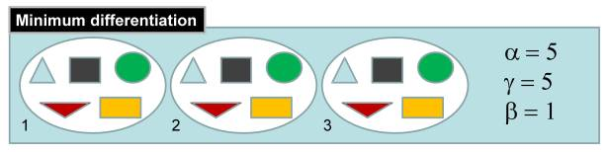
Beta diversity is a metric used to asses the diversity between microbial communities
Dr. Andres Baselga
Notes:
Beta diversity refers to the differences in microbial community composition between different habitats or samples. It measures the degree of similarity or dissimilarity between communities, and can help identify factors that contribute to differences in microbial community structure.
Beta diversity can be visualized using various methods such as ordination plots, hierarchical clustering dendrograms, and distance matrices. Here are some links to figures that may help explain beta diversity:
https://methodsblog.com/2015/05/27/beta_diversity/

Slide 48
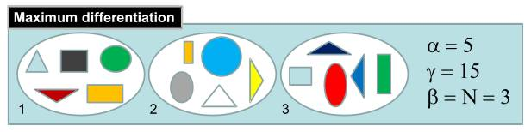
Beta diversity is a metric used to asses the diversity between microbial communities
Dr. Andres Baselga
Notes:
Beta diversity refers to the differences in microbial community composition between different habitats or samples. It measures the degree of similarity or dissimilarity between communities, and can help identify factors that contribute to differences in microbial community structure.
Beta diversity can be visualized using various methods such as ordination plots, hierarchical clustering dendrograms, and distance matrices. Here are some links to figures that may help explain beta diversity:
https://methodsblog.com/2015/05/27/beta_diversity/

Slide 49
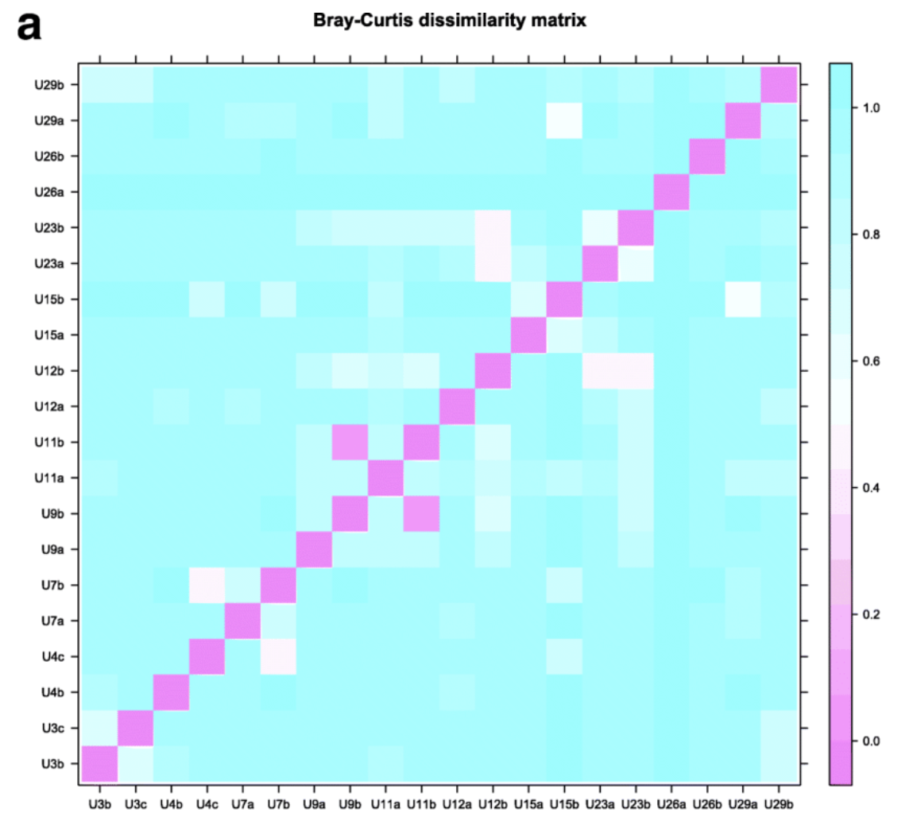
Beta diversity is a metric used to asses the diversity between microbial communities
Frontiers in Microbiology, 2019
Notes:
Beta diversity refers to the differences in microbial community composition between different habitats or samples. It measures the degree of similarity or dissimilarity between communities, and can help identify factors that contribute to differences in microbial community structure.
There are different types of beta diversity like bray Curtis, jaccard, unifrac, weighted unifrac, and Manhattan.

Slide 50
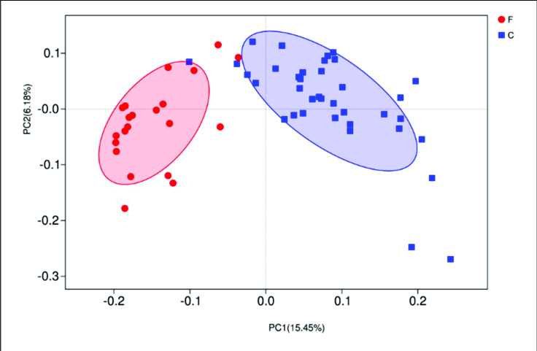
Beta diversity is a metric used to asses the diversity between microbial communities
Frontiers in Microbiology, 2019
Notes:
Beta diversity refers to the differences in microbial community composition between different habitats or samples. It measures the degree of similarity or dissimilarity between communities, and can help identify factors that contribute to differences in microbial community structure.
Beta diversity can be visualized using various methods such as ordination plots, hierarchical clustering dendrograms, and distance matrices. Here are some links to figures that may help explain beta diversity:

Slide 51
Microbiome Analysis
Part 1
Part 2
Part 3
Part 4
Experimental Design
DADA2
QC filtering, trimming, and merging
Building ASV counts table and preparing metadata
Phyloseq
Alpha diversity, beta diversity, relative abundance
Statistics on Microbiome Data
Data formatting and common statistical analyses
Have a broad understanding of microbiome experimental design.
Start with fastq files and end with a ASVcounts table.
Build a phyloseq object and make some figures using ggplot2 syntax.
Learn how to complete simple stats on alpha diversity, beta diversity, and relative abundance.

Slide 52
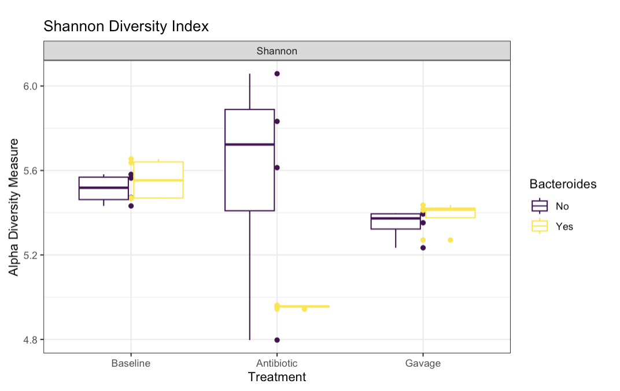
Alpha Diversity
Hypothesis: There is a difference in alpha diversity between Bacteroides groups.
Run Wilcoxon rank sum with FDR correction between Bacteroides groups at each treatment.
Log2 transform the Shannon diversity and run linear model to account for both Bacteroides and factors like CageNumber and Mouse
Notes:
Null hypothesis is that there is no difference in alpha diversity between Bacteroides groups.
The Wilcoxon rank sum test, also known as the Mann-Whitney U test, is a non-parametric statistical test used to compare two independent groups and assess whether their distributions are different. In the context of alpha diversity analysis, it can be used to compare the diversity measures (e.g., species richness, Shannon diversity index, Simpson's index) between two groups, often representing different conditions or treatments.
Assumptions of the Wilcoxon Rank Sum Test:
Independence: The observations within each group are independent of each other, and the two groups are also independent.
Continuity: The data points are continuous or can be treated as continuous (e.g., ordinal data).
Similarity of Distributions: The shapes of the two distributions being compared (between the two groups) are similar, except for any shift in location (i.e., difference in medians).
The False Discovery Rate (FDR) correction is a method used to address the issue of multiple hypothesis testing. When conducting multiple statistical tests simultaneously (e.g., comparing alpha diversity at multiple taxonomic levels or across different time points), the probability of obtaining at least one false positive result increases. FDR correction controls the overall rate of false discoveries while allowing for some significant results.
A linear model, in the context of Shannon diversity analysis, is used to explore and quantify the relationship between Shannon diversity index and one or more explanatory variables.

Slide 53
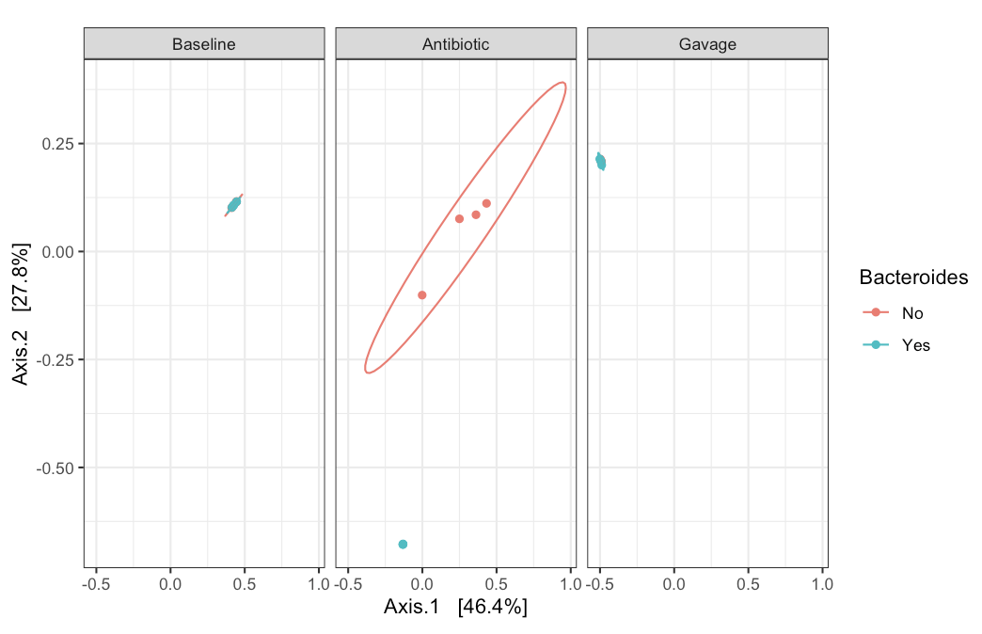
Beta Diversity
Hypothesis: There is a difference in beta diversity between Bacteroides groups.
PERMANOVA

Slide 54
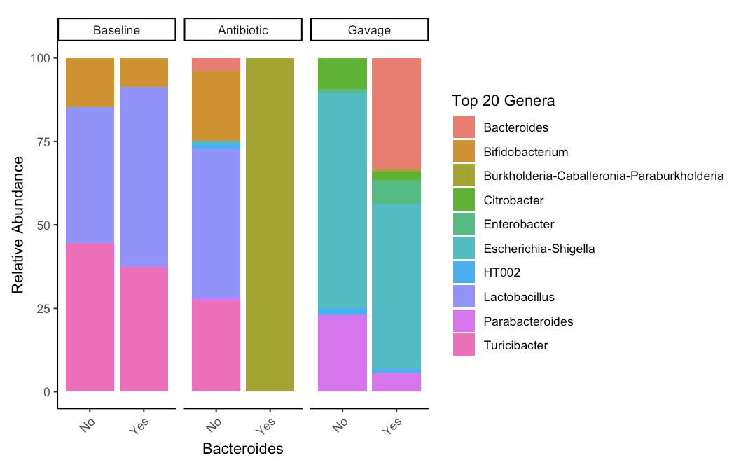
Relative abundance

Slide 55
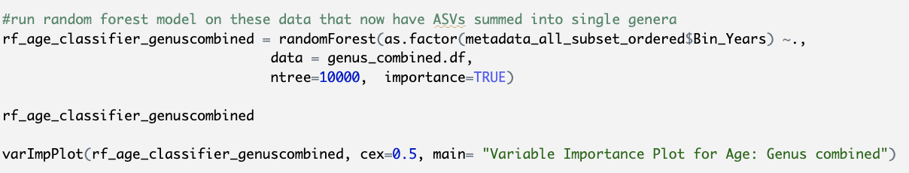
Random Forest Model

